Slide 1

P4P : Provider Portal for (P2P) Applications
Y. Richard Yang
Laboratory of Networked Systems
Yale University
Version: May 9, 2008

Slide 2
Acknowledgements
Joint work with
  Haiyong Xie (Yale)
  Arvind Krishnamurthy (University of Washington)
  Members of Yale Laboratory of Networked Systems (LANS): Richard Alimi, Hao Wang, Ye Wang, Glenn Thrope
  Avi Silberschatz (Yale)
Extremely grateful to
  Charles Kalmanek (AT&T Labs)
  Marty Lafferty (DCIA)
  Doug Pasko (Verizon)
  Laird Popkin (Pando)
  Rich Woundy (Comcast)
  Members of the P4P working group
Some slides are from the NANOG presentation by Pasko and Popkin

Slide 3
Outline
The problem
The P4P framework
The virtual cost interface
Evaluations
Discussions and ongoing work

Slide 4
Content Distribution using the Internet
projection
The Internet is increasingly being used for digital content and media delivery.
“Within five years, all media will be delivered across the Internet.”
- Steve Ballmer, CEO Microsoft, D5 Conference, June 2007
Notes:
The context of the P4P project is content distribution in the Internet.
Not only web documents, but also software, sw update, books, video, movie rental, and many more measurement collections

Slide 5
Challenges: Content Owner’s Perspective
Content protection/security/monetization
Distribution costs

Slide 6



Traditional Client-Server
More users
Worse performance (C₀/n)
Higher cost
server
C₀
client 1
client n
client 2
Slashdot effect, CNN on 9/11

Slide 7
Bandwidth Demand
“Desperate Housewives” available from ABC
  one hour (320x240 H.264 iTunes): 210MB
  assume 10,000,000 households downloads
  ⇒ 3 days @ 64Gbps non-stop !
HD video is 7~10 times larger than non-HD video
http://dynamic.abc.go.com/streaming/landing?lid=ABCCOMGlobalMenu&lpos=FEP
http://www.pbs.org/cringely/pulpit/pulpit20060302.html; Will Norton Nanog talk
Notes:
Mention 320x240 is no HD

Slide 8
Classical Solution: IP Multicast
Ideal for applications such as live streaming
Issues
  less effective for asynchronous content distribution
  lacking of billing model
  requirement for multi-ISP cooperation
  …

Slide 9
Classical Solution: Cache, CDN
server 1
server 2
Success story: Akamai
  ~25,000
  servers worldwide
  a content owner
  may be allocated
  hundreds of servers
Issues
  expensive
  limited capacity: “The
  combined streaming
  capacity of the top 3
  CDNs supports one
  Nielsen point.”
C₀
client 1
client 2
client n
client n/2
Notes:
Content Distribution networks
Akamai 25000 servers world wide; each client can be allocated hundreds of servers
But expensive, limited capacity
Focus on P2P, but P4P can integrate others

Slide 10
Scalable Content Distribution: P2P
Peer-to-peer (P2P) as an extreme case of
multiple servers:
  each client is also a server
Benefits
  low cost to the content owners: BW and processing are (mostly) contributed/paid by end users
  scalability/capacity: claim by one P2P: 10 Nielsen points

Slide 11
Integrating P2P into Content Distribution
Initially
  standalone applications
  rogue technology (e.g., copyright issues)
Recent development:
  becoming a key component of content delivery infrastructure for legal content
    integrated P2P + server solutions
  some projects
    iPlayer (BBC), Joost, Pando (NBC Direct), BT (Linux)
    Verizon P2P, Thomson/Telephonica nano Data Center
Some statistics
  15 mil. average simultaneous users
  80 mil. licensed transactions/month

Slide 12
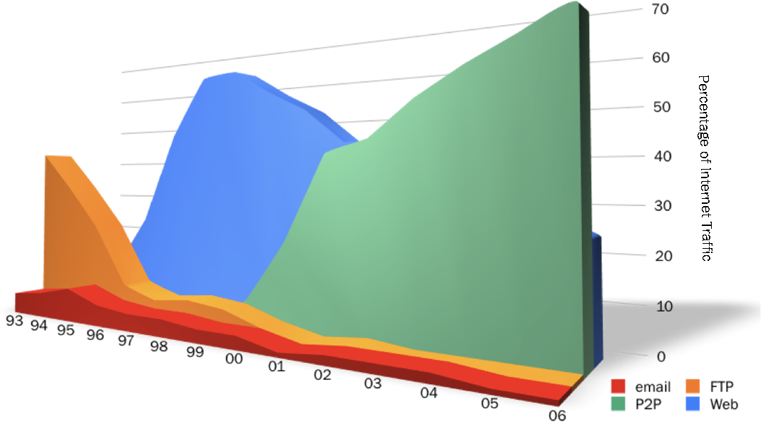
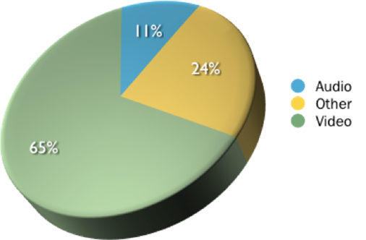
P2P : Bandwidth Usage
Traffic: Internet Protocol Breakdown 1993 - 2006
File-Types: Major P2P Networks - 2006
Up to 50-70% of Internet traffic is contributed by P2P applications
Cache logic research: Internet protocol breakdown 1993 – 2006;
Velocix: File-types on major P2P networks.
Notes:
P2P:
(1) bandwidth-demanding video streaming P2P applications,
(2) P2P-based content distribution is also becoming more and more popular, e.g., BitTorrent is used to distribute software updates, download movies

Slide 13
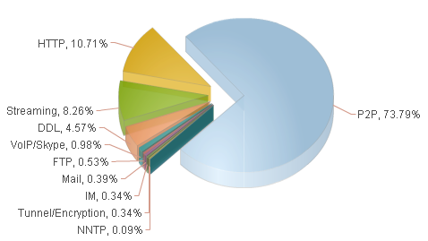
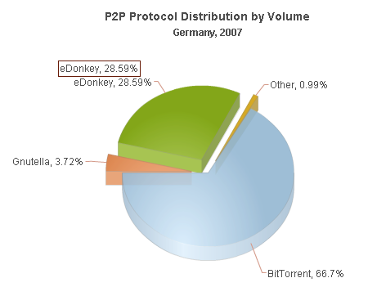
P2P : Bandwidth Usage
Germany: 70% Internet traffic is P2P
ipoque: Nov. 2007
Notes:
P2P:
(1) bandwidth-demanding video streaming P2P applications,
(2) P2P-based content distribution is also becoming more and more popular, e.g., BitTorrent is used to distribute software updates, download movies

Slide 14
P2P Problem : Network Inefficiency
Network-oblivious P2P applications may not be network efficient
  Verizon
    average P2P bit traverses 1000 miles
    average P2P bit traverses 5.5 metro-hops
  Karagiannis et al. on BitTorrent, a university network (2005)
    50%-90% of existing local pieces in active users are downloaded externally
Notes:
Clearly P2P is popular and good to content owners. However, from the network’s perspective, P2P is a problem. One key problem is network inefficiency.

Slide 15
P2P Problem: Inefficient Interactions
  ISP: traffic engineering to change routing to shift traffic away from highly utilized links
    current traffic pattern ➔ new routing
  adaptive P2P: direct traffic to better performing peers
    current routing matrix ➔ new traffic pattern
There exists inefficient Nash equilibrium point
Selfish routing : SIGCOMM 2003

Slide 16
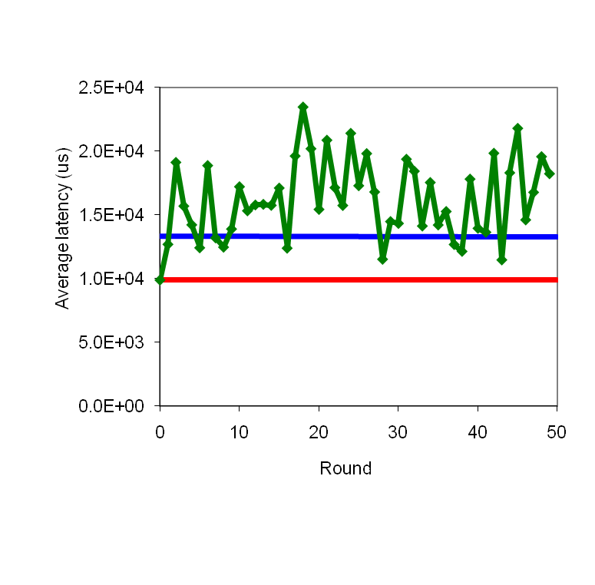
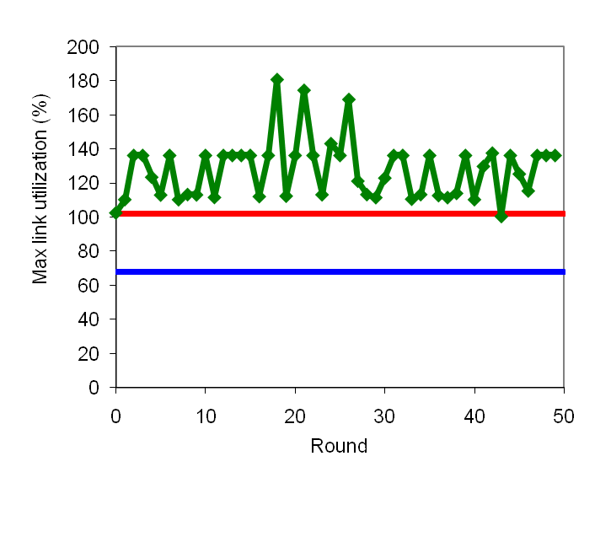
ISP Traffic Engineering+ P2P Latency Optimizer
red: adaptive P2P adjusts alone; fixed ISP routing
blue: ISP traffic engineering adapts alone; fixed P2P communications
ISP optimizer interacts poorly with adaptive P2P.
Notes:
red p2p alone
blue: TE alone

Slide 17
P2P Problems
Internet Transit
Regional Routers
Edge Network
Network oblivious app
→ network inefficiency
Poor ISP/P2P interactions

Slide 18
Attempts to Address P2P Problems
ISPs Approaches
increase capacity
pricing
rate-limit/terminate
P2P traffic
deploy P2P caching
devices
P2P Approaches
locality aware P2P
Notes:
ISP:
- upgrade network infrastructure – this can dramatically increase ISP’s financial operational cost; not solving the efficiency problem
Pricing: usage-based pricing reduces subsidy of avg users to heavy users; see news http://www.businessweek.com/ap/financialnews/D90H25UO0.htm
but not solving the efficiency problem
rate limit/terminate P2P traffic – bad user experience, less affective in a competitive environment
not solving the efficiency problem
- P2P caching devices – cost to ISP, legal issues (depends on Law exceptions), P2P encryption (20%); new P2P applications emerging; a precedent that ISPs may not want to set (to encourage cost shifting)
P2P locality peering
- P2P can infer some network information; however, a lot of important information cannot be inferred, for example policies and cost

Slide 19
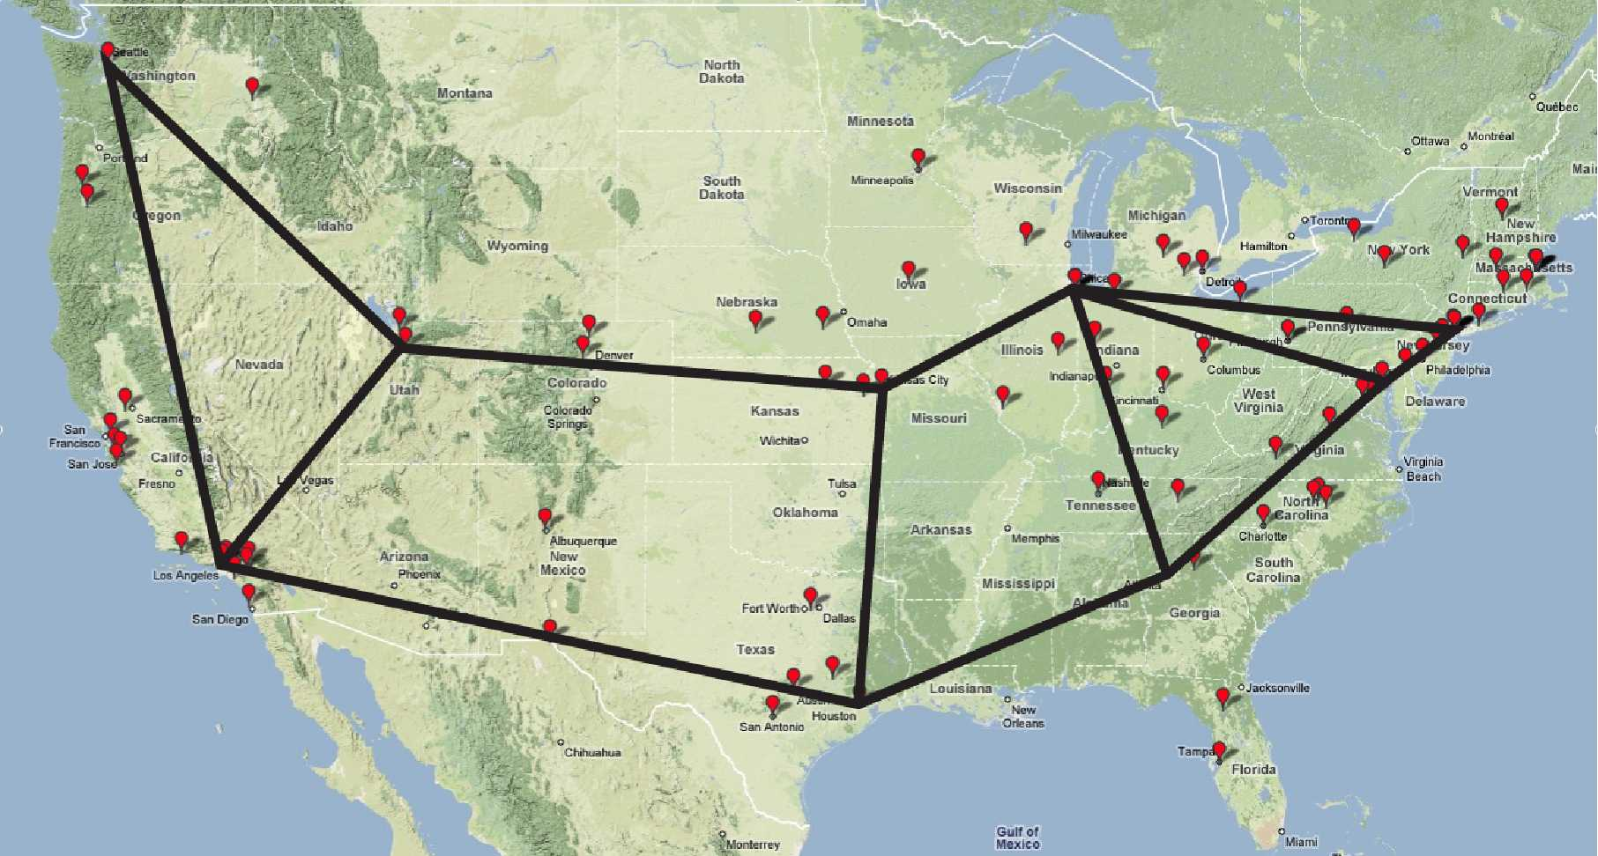
Issues of Pure Locality Based Peering
Notes:
Use the example link between New York and DC: a local link in terms of latency or hop count, but often a busy link. Maybe better offer is NYC divert to Chicago and DC to Chicago and Atlanta links
Overhead
Redundancy, overhead (churn)
Ineffective:
- MPLS limit application view
Loss and etc are screwed
In interdomain,
Policy and cost are hard to infer
To really understand the limitation of pure P2P-based locality based peering, think about daily life.

Slide 20
A Fundamental Problem
Traditional Internet architectural feedback to applications is limited:
  routing (hidden)
  rate control through coarse-grained TCP congestion feedback
Emerging applications such as P2P can have tremendous flexibility in shaping how data is communicated
  to most effectively utilize this flexibility for improving network efficiency, the network needs to provide more information and feedback
Notes:
The limitations on the effectiveness of pure P2P-based locality based peering reflects a fundamental issue in Internet architecture: Traditional Internet architectural feedback to applications is limited.
ISPs do not disclose their network information for various concerns

Slide 21


Slide 22
Outline
The problem
The P4P framework

Slide 23


Slide 24
P4P Mission
Design a framework to enable better providers and applications cooperation
Open standard: any ISP, provider, application can easily implement it
P4P: provider portal for (P2P) applications
  a provider can be
    a traditional ISP (e.g., AT&T, Verizon) or
    a content distribution provider (e.g., Akamai), or
    a caching provider (e.g., PeerApp)
Notes:
The motivation for involving ISPs in this process :
ISPs are best positioned with respect to gathering information regarding the state of the network and the needs of
P2P systems. By letting ISPs make recommendations and letting the peer-to-peer systems use these as hints
in their peering process, we hope to design a system that is efficient and incurs low operational costs

Slide 25
P4P Objectives
ISP perspective:
  guide applications to achieve more efficient network usage, e.g.,
    avoid undesirable (expensive/limited capacity) links to more desirable (inexpensive/available capacity) links
Resource providers (e.g., caching, CDN, ISP) perspective
  provide applications with on-demand resources/quality
P2P perspective:
  better performance for users
  decreased incentive for ISPs to “manage” applications
Notes:
The motivation for involving ISPs in this process :
ISPs are best positioned with respect to gathering information regarding the state of the network and the needs of
P2P systems. By letting ISPs make recommendations and letting the peer-to-peer systems use these as hints
in their peering process, we hope to design a system that is efficient and incurs low operational costs

Slide 26
The P4P Framework
Data plane
  applications mark importance of traffic
  routers mark packets to provide faster, fine-grained feedbacks
Management plane
  monitoring compliance
Control plane

Slide 27
The P4P Framework: Control Plane
iTracker: a portal for each network resource provider (should have called iPortal)
An iTracker provides multiple interfaces
    each provider decides the interfaces it provides
    each interface is encoded in Web Service Definition Language (WSDL) for extensibility
iTracker of a provider can be identified in multiple ways
    e.g., through DNS SRV records; whois
    iTracker can be run by trusted third parties
iTracker access protected by access control

Slide 28
Example Interfaces
Static topology/policy interface
  connectivity
  traffic balance ratio for inter-AS peering links, time of day preference
Provider capabilities interface
  P2P requests QoS, CoS
  cache/ISP server discovery and participation as special clients
    to allow better hybrid integration
Virtual cost interface
…
Notes:
Session independent
Session dependent
Rendezvous Points

Slide 29
Outline
The problem
The P4P framework
The virtual cost interface

Slide 30
Major Design Requirements
Simplicity and intuitive interpretation
  to both network operators and application developers (may imply two views)
Both ISP and application control
  no one side dictates the choice of the other
  application still has capability for optimization: P2P vendors compete on optimization techniques; ISP involvement should not make this extremely hard or impossible
Extensibility and neutrality
  ISP: application-agnostic info (not a mechanism that may be perceived for ISPs to manipulate info/decision to play “favorites” for particular types of app)
  application: no need to know network specific details/objectives, but fine-grained enough info for good optimization
Notes:
Simplicity and ease of implementation
Scalability
Extensibility: support diverse ISP objectives and applications scenarios in large networks
Fault tolerant
Privacy preservation
Mention the 1Mbps inside, 5 outside selection issue

Slide 31
Major Design Requirements (Cont’)
Scalability
  ISP: avoid handling per peer-join request
  application: local/cached info from ISP useful during both initial peer joining and re-optimization
Privacy preservation
  ISP: information (spatial, time, status, and policy) aggregation and transformation (e.g., interdomain link cost to congestion level due to virtual capacity)
    e.g., some ISPs already publically report aggregated performance: e.g., AT&T, Qwest inter-city performance http://stat.qwest.net/index_flash.html
  application client privacy from ISP: no individual session info sent to ISP
  P2P vendor privacy: no revealing of client base information
Fault tolerance
Notes:
Simplicity and ease of implementation
Scalability
Extensibility: support diverse ISP objectives and applications scenarios in large networks
Fault tolerant
Privacy preservation
Mention the 1Mbps inside, 5 outside selection issue

Slide 32
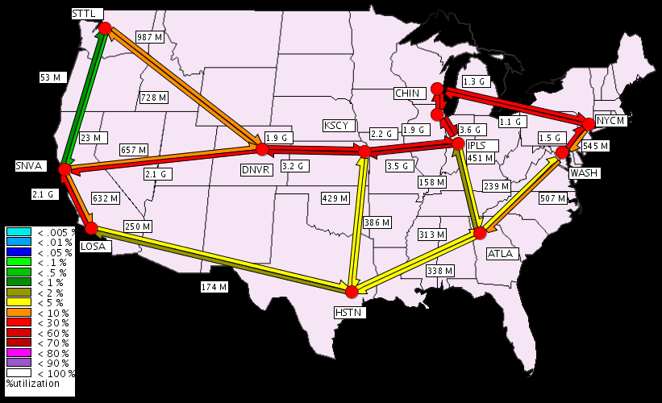
The Virtual Cost Interface:
Network’ Internal View
PIDs: set of nodes
E: set of links
connecting PIDs
p_{e}: the “virtual price”
(vPrice) of link e
  the higher the price, the
  more “cost” to the ISP if an
  application uses the link
  vPrice reflects both network status and policy, e.g.,
    higher prices on links with highest util. or higher than a threshold
    OSPF weights
Notes:
First intradomain

Slide 33
The Virtual Cost Interface: Applications’ View
Each pair of PIDs has “cost”
Perturbed
PID1
70
PID2
30
10
60
20
PID6
PID3
Applications adjust traffic
patterns to place less load
on more “expensive” pairs
PID5
PID4

Slide 34
IP-PID Mapping
A client maps its IP address to (AS, PID)
Multiple possibilities
  a client obtains this mapping when it obtains its IP address or the client application first starts up
    refreshed once in a while
    access control: mapping send to the IP that is the subject of the query
  for incremental deployment , application view
    each PID has associated IP “prefix”

Slide 35
Outline
The problem
The P4P framework
The virtual cost interface
  scheme
  apply to P2P

Slide 36




Background: P2P Peer Selection
HTTP GET MYFILE.torrent
MYFILE.torrent
webserver
user
“register”
list of peers
ID1 169.237.234.1:6881
ID2 190.50.34.6:5692
ID3 34.275.89.143:4545
…
ID50 231.456.31.95:6882
pTracker
…
Use BitTorrent in a single
ISP as an example
Peer 40
Peer 1
Peer 2

Slide 37
Using Virtual Topology by BT
Information flow:
  1. peer queries pTracker
  2/3. pTracker asks iTracker for virtual cost (occasionally)
  4. pTracker selects and returns a set of active peers, according to both the virtual prices and its own P2P objective
pTracker
iTracker
2
3
1
4
ISP A
peer

Slide 38
P2P Using the Virtual Cost:
Virtual Price as a Ranking Function
The lower the price to an (AS, PID), the higher the rank of peers in it
Issues
  P2P applications use structured peer selection, e.g., achieve certain connectivity, select one super peer, …

Slide 39
P2P Using the Virtual Cost:
Black-box Approach
Many P2P applications pick peers in a structured way, but have a random component to pick peers, e.g., BT-derived
pTracker runs the peer selection algorithm multiple times and picks the one with the lowest weighted cost
  a randomized algorithm
  still allows structured peer selection

Slide 40
P2P Using the Virtual Cost:
Convert vPrice to Weight Matrix
Convert vPrice to weights: inverse proportional to price
Are connected to users in these PIDs
 | PID1 | PID2 | PID3 | PID4 | PID5 | PID6
PID1 |  | 30% | 10% | 5% | 3% | 20%
PID2 | 30% |  | 20% | 10% | 6% | 10%
PID3 | 30% | 50% |  | 5% | 3%
PID4 | 7% | 10% | 2% |  | 60% | 3%
PID5 | 4% | 6% | 1% | 60% |  | 1%
PID6 | 30% | 25% | 5% | 2% | 1%
Users
in
PIDs
Notes:
Mention the 1Mbps in, 5 Mbps out example
Mention robustness, e.g., 15% random

Slide 41
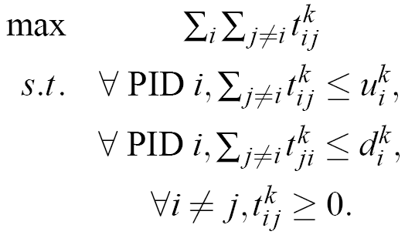

P2P Using the Virtual Cost: Optimization
Suppose a P2P application does matching:
  where β is tolerance, say 80%.

Slide 42
Summary: How to Use the Virtual Cost Interface?
ISP
Application
Manual vPrice
configuration
Blackbox usage
of vPrice
vPrice to Peer Selection Weight Matrix

Slide 43
Outline
The problem
The P4P framework
The virtual cost interface
  basics
  the virtual cost interface as an optimization decomposition interface

Slide 44
Example: Minimize MLU
Question: How to set the “virtual prices” on the links?
Notes:
First intradomain

Slide 45
The Virtual Cost Interface: P2P Notation
Assume K applications running inside the ISP
Let T^{k} be the set of acceptable traffic patterns for application k
  an element t^{k} in T^{k} specifies a traffic demand matrix t^{k}_{ij} for each pair of PIDs (i,j)

Slide 46
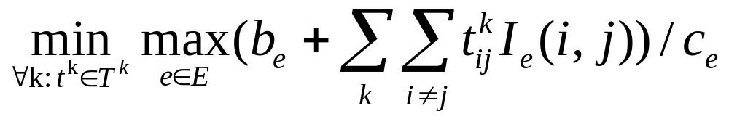
The Virtual Cost Interface
I_{e}(i, j): indicator if link e is on the route from PID i to PID j
b_{e}: amount of background traffic on link e

Slide 47
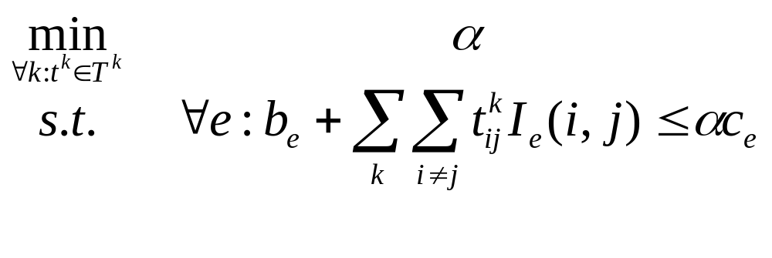
ISP MLU: Transformation

Slide 48
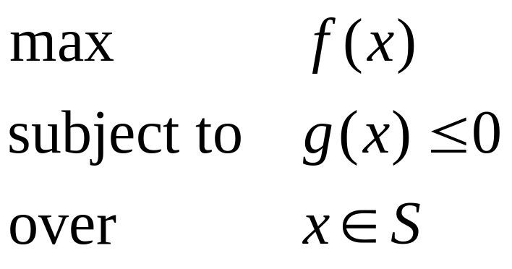
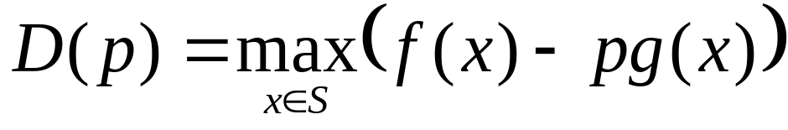
A One-Slide Summary of Optimization Theory
Introduce p for the constraint:
p (>= 0) is called shadow price in economics
D(p) is called the dual
f(x)
p₁
p₂
S
D(p) provides an upper bound on solution.
- Then according to optimization theory: when D(p) achieves minimum over all p (>= 0), then the optimization objective is achieved when certain concavity conditions are satisfied.
g(x)

Slide 49
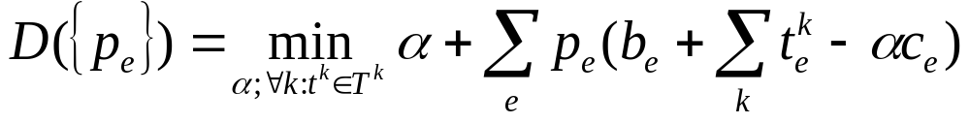
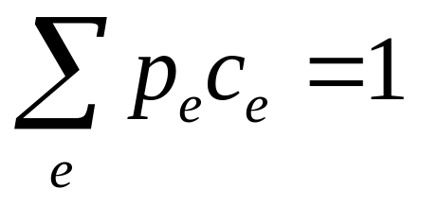
ISP MLU: Dual
Introducing dual variable p_{e} (≥ 0) for the inequality of each link e
To make the dual finite, need

Slide 50
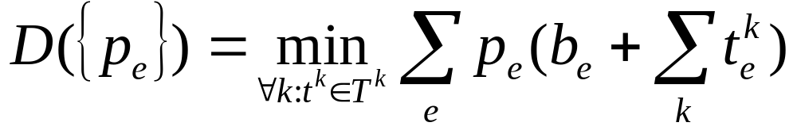
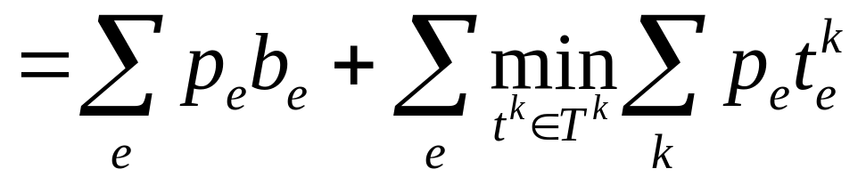
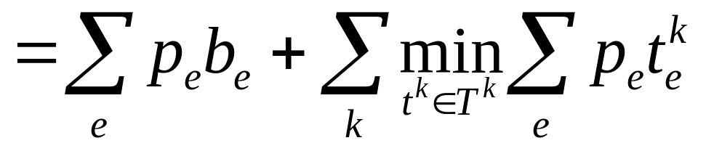
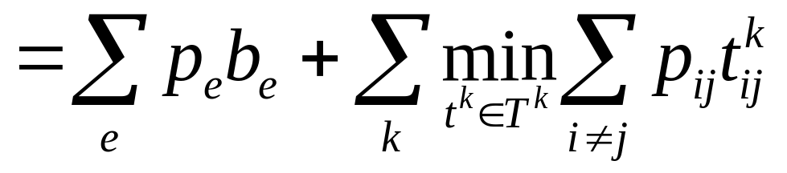
ISP MLU: Dual
Then the dual is
where p_{ij} is the sum of p_{e} along the path from PID i to PID j

Slide 51
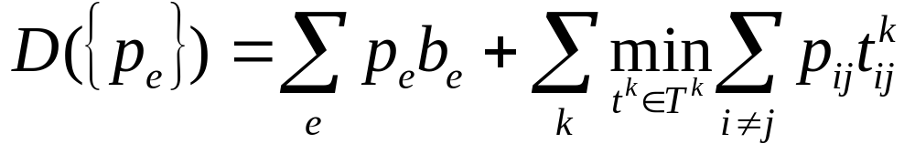
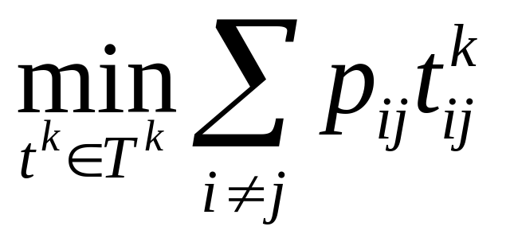
ISP MLU Dual : Interpretation
P2P k chooses t^{k} in T^{k} to minimize weighted sum of t_{ij}
The interface between an application and the ISP is the “shadow prices” {p_{ij}}

Slide 52
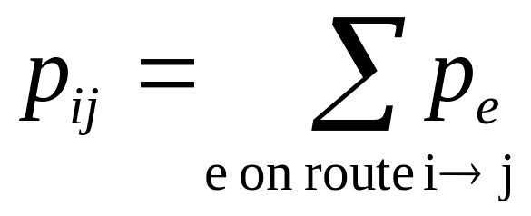
Interpreting Network Guidelines
p_{e1}(t)
p_{e2}(t)
t^{k}(t)

Slide 53
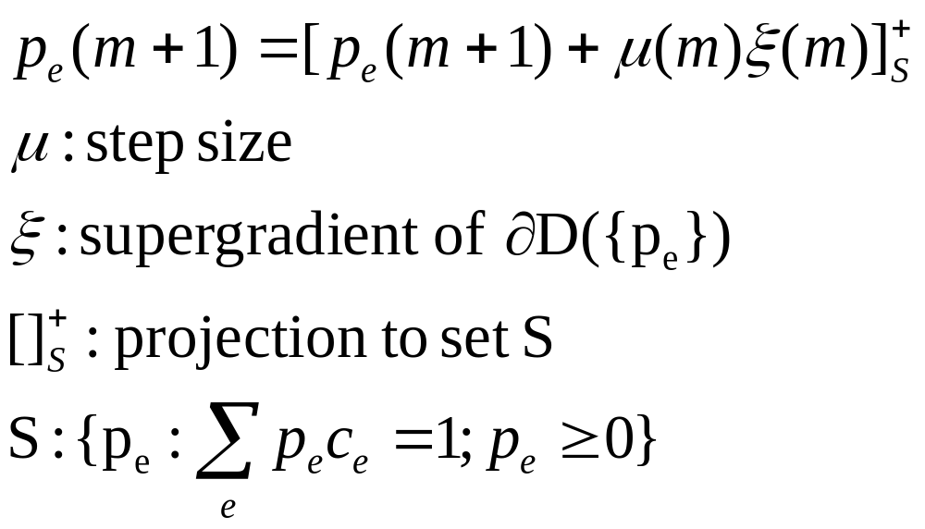
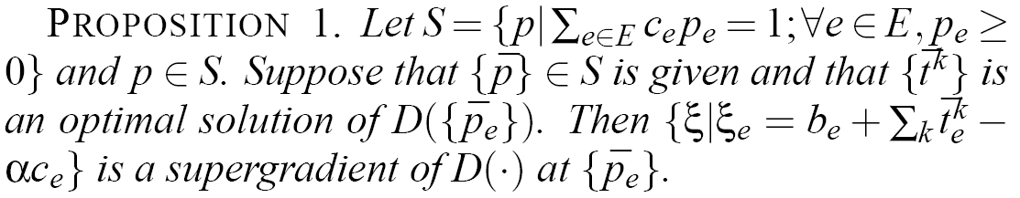
ISP “vPrice” Update
At update m+1,
calculates

Slide 54
Summary: How to Use the Virtual Topology Interface?
ISP
Application
Manual vPrice
configuration
Blackbox usage
of vPrice
vPrice
by Primal-Dual
vPrice to Peer Selection Weight Matrix

Slide 55
Outline
The problem
The P4P framework
The virtual topology interface
  basics
  the virtual cost interface as an optimization decomposition interface
  interdomain

Slide 56
Interdomain: Internal View
(AS2, PID2)
vPrice?
PID1
PID2
(AS2, PID3)
PID6
PID3
vPrice?
PID5
PID4

Slide 57
Interdomain: Application External View
Application obtains cost for top (AS, PID) pairs
Intradomain cost + interdomain cost
From AS 1’s point view
(AS1, PID1)
(AS2, PID2)
Intradomain cost + interdomain cost
From AS 2’s point view

Slide 58
Simple Interdomain: Multihoming
Multihoming
  a common way of connecting to Internet
  improve reliability
  improve performance
  reduce cost
ISP 1
Internet
ISP
ISP 2
ISP K

Slide 59
Interdomain
Provider1
vPrice?
PID1
PID2
Provider 2
vPrice?
PID6
PID3
vPrice?
PID5
PID4
Provider 3

Slide 60
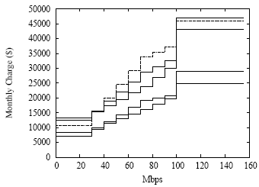
Network Charging Model
Cost = C₀ + C(x)
  C₀: a fixed subscription cost
  C: a non-decreasing function
  mapping x to cost
  x: charging volume
    total volume based charging
    percentile-based charging (95-th percentile)

Slide 61
Percentile Based Charging
Sorted volume
95%*N
N
Interval
Charging volume: traffic in the (95%*N)-th sorted interval

Slide 62
Interdomain Cost Optimization:
Problem Specification (2 ISPs)
Sorted volume
Volume
v1
Sorted volume
Time
v2
Goal: minimize total cost = C1(v1)+C2(v2)

Slide 63
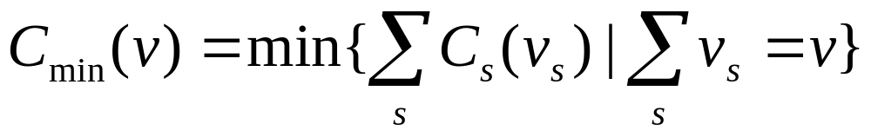
Insight 1
Let V0 denote the sum of all ISPs’ charging volumes
Minimize cost ⬅➔ Minimize V0

Slide 64
Insight 2
The minimum V0 is the 1- ∑_{s=1..N}(1-q_{s}) quantile of total traffic, where q_{s} is ISP s’ charging percentile
  e.g., suppose two ISPs with q_{s} = 0.95
  then 1- [(1-0.95) + (1-0.95)] = 0.90

Slide 65
Sketch of ISP Algorithm
Determine charging volume for each ISP
  compute V0
  find v_{s} that minimize ∑_{s} c_{s}(v_{s}) subject to ∑_{s}v_{s}=V0 using dynamic programming
Assign traffic given charging volumes
  non-peak assignment: ISP s is assigned ≤ v_{s}
  peak assignment:
    first let every ISP s serve its charging volume v_{s}
    dump all the remaining traffic to an ISP s that has bursted for fewer than (1-q_{s})*N intervals

Slide 66
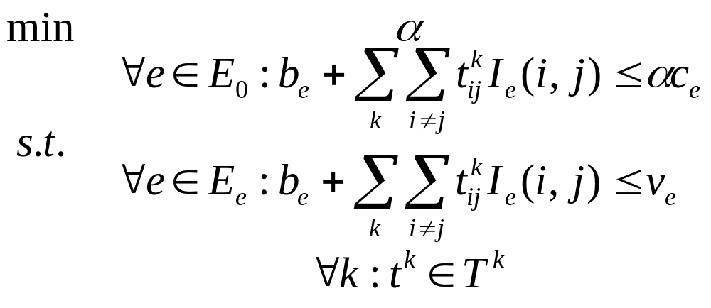
Integrating Cost Min with P4P
Notes:
Interdomain

Slide 67
Outline
The problem
The P4P framework
The virtual cost interface
Evaluations
  P4P-MLU (simulation)

Slide 68
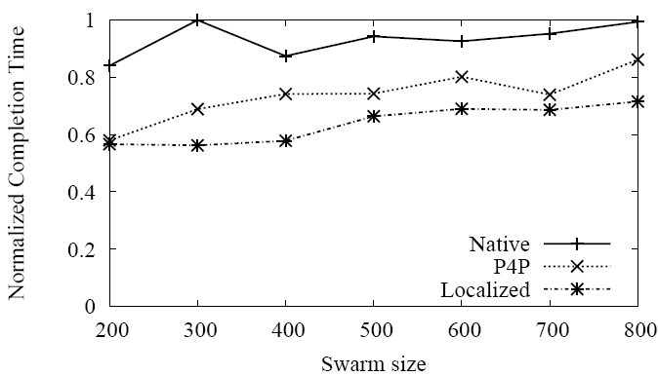
BitTorrent on ISP-A: Completion Time
P4P achieves rate between latency-based localized and native BT.

Slide 69
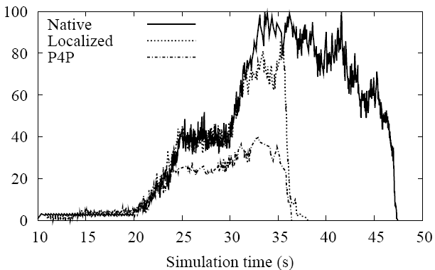
BitTorrent on ISP-A: Bottleneck Utilization
The utilization of P4P is less than one-half of localized,
which achieves lower than native.

Slide 70
Outline
The problem
The P4P framework
The virtual topology interface
Evaluations
  P4P-MLU (simulation)
  P4P-multihoming (Abilene emulation experiments)

Slide 71
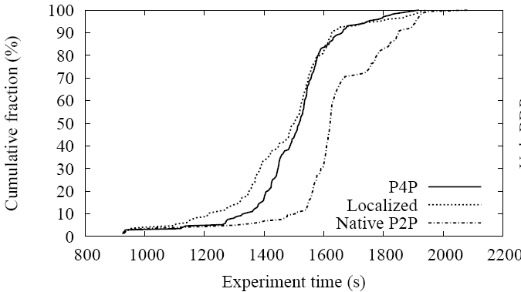
BitTorrent on Abilene Interdomain: Completion Time
P4P achieves similar application performance with localized at percentile higher from 50%. P4P has a shorter tail.

Slide 72
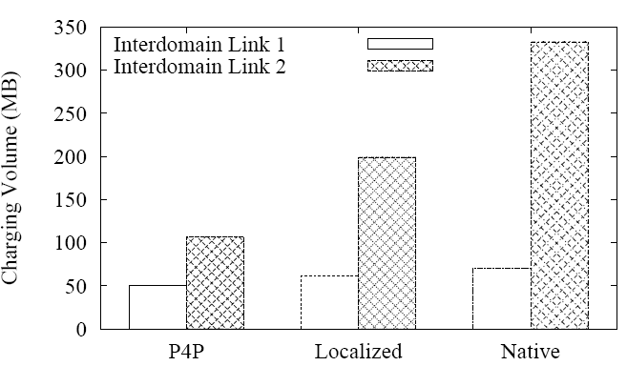
BitTorrent on Abilene: Charging Volumes
For the charging volume of the second link: native BT is 4x of P4P; delay-localized is 2x of P4P

Slide 73
Outline
The problem
The P4P framework
The virtual topology interface
Evaluations
  P4P-MLU (simulation)
  P4P-multihoming (Abilene emulation experiments)
  Field tests

Slide 74
Field-Tests
Initial field test: Feb. 21 - Mar. 2, 2008
P2P: Pando, 20 Mbytes video to 1.25 million users opted in for newsletters
Peers partitioned into: Native, P4P
Run iTracker at Yale for Verizon
  one load-balancer, two iTrackers (for fault tolerance)
  iTracker maps “virtual price” to peering weight directly
  iTracker objective: MLU
  Verizon: static map and user capacity type

Slide 75
Field-Test Configuration
P2P
Clients
P2P
Tracker
ISP
iTracker
Telefonica
Weight Matrix
Yale
Pando
Network
Maps
Verizon

Slide 76
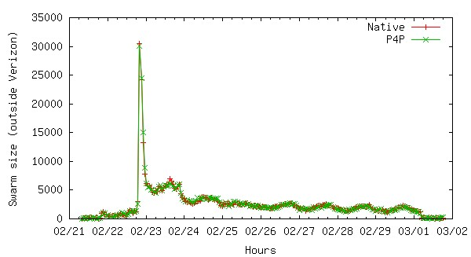
Swarm Size: outside Verizon

Slide 77
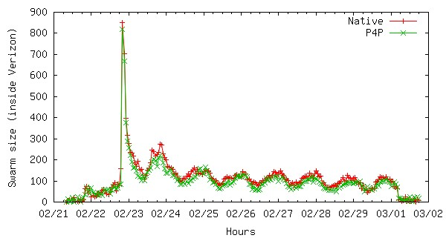
Swarm Size: inside Verizon

Slide 78
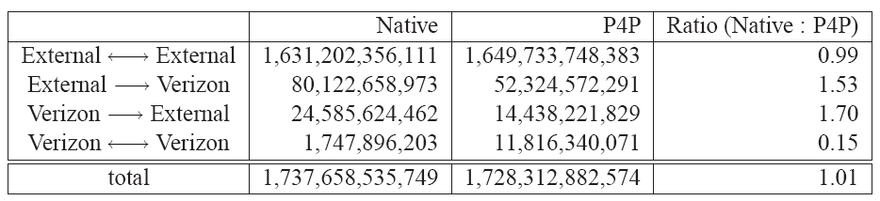
ISP Perspective: Overall
Ingress to Verizon: Native is 53% higher than P4P
Egress from Verizon: Native is 70% higher than P4P
Intradomain: Native is only 15% of P4P
Initial field test: Feb. 21 - Mar. 2, 2008

Slide 79
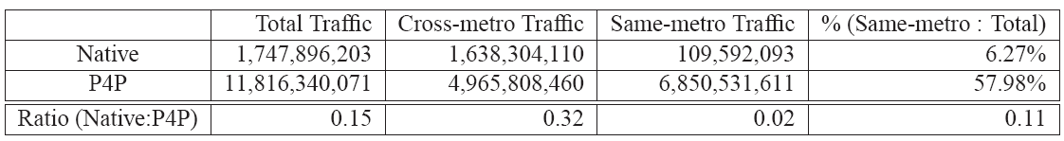
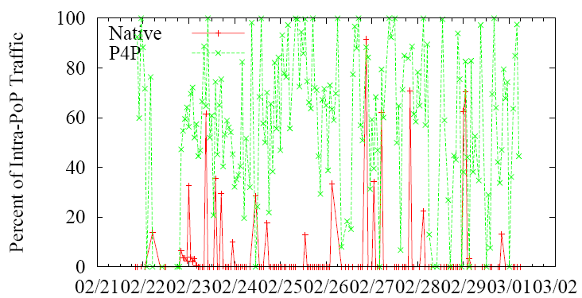
ISP Perspective: Traffic within Verizon
Initial field test: Feb. 21 - Mar. 2, 2008

Slide 80
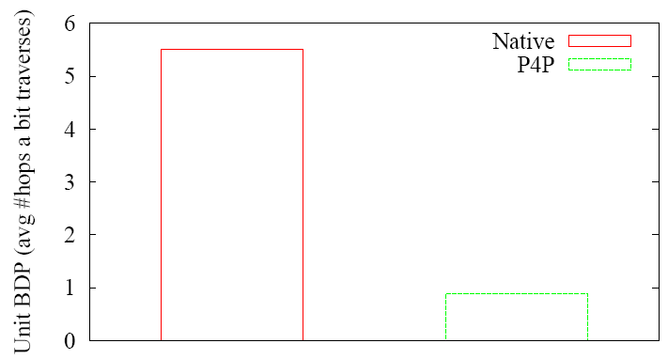
ISP Perspective: Average Hop Each Bit Traverses
5.5
0.89
Why less than 1: many transfers are in the same metro-area; same metro-area peers are utilized more by tit-for-tat.
Initial field test: Feb. 21 - Mar. 2, 2008

Slide 81
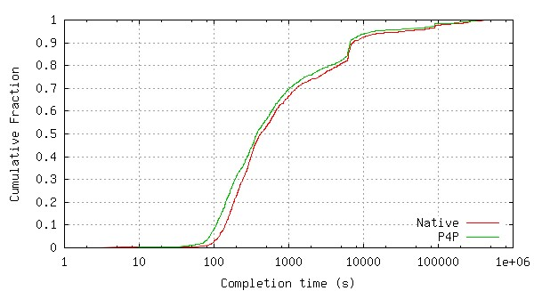
P2P Perspective: Completion Time
P4P improves completion time by 23%.
Initial field test: Feb. 21 - Mar. 2, 2008

Slide 82
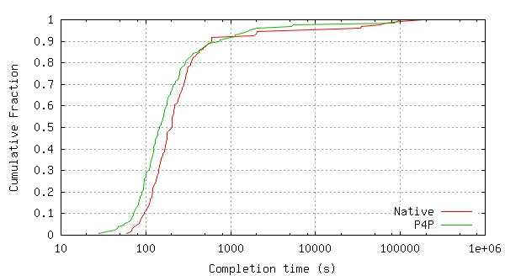
P2P Perspective: Completion Time(FTTP)
P4P improves FTTP completion time by 68%.
Initial field test: Feb. 21 - Mar. 2, 2008

Slide 83
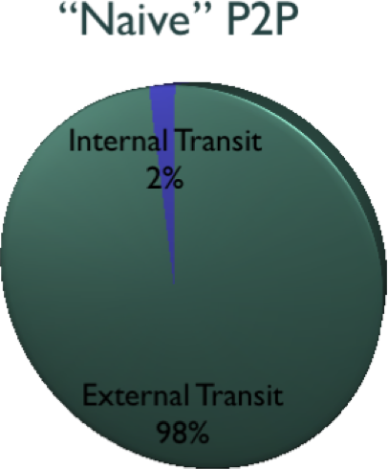
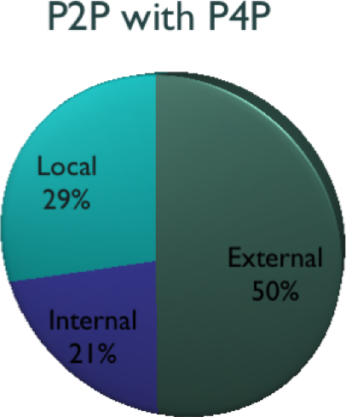
Complete Set: Feb 21 to April 2008
FTTP 209% faster
Non-FTTP 20% faster

Slide 84
Summary
P4P: provider portal for (P2P) applications
Address the following issues:
  explicit integration of network servers or caches to reduce network load
    the capabilities interface
  enabling applications to signal their bandwidth and priority to networks
    the capabilities interface and the data plane
  enabling ISPs to signal applications network status and policies
    the virtual cost interface

Slide 85
Discussions: P4P Efficiency
Internet Transit
ISP Backbone
Edge Network
Better at interdomain transit and ISP backbone
For last mile
  load balancing among last miles, depending on diversity
  one-level up (ISP servers/caches) further reduces upstream load

Slide 86
Current P4P-WG
Core Group | AT&T Bezeq Intl BitTorrent Cisco Systems Comcast Grid Networks Joost LimeWire | Manatt Oversi Pando Networks PeerApp Solid State Telefonica Group Velocix VeriSign | Verizon Vuze University of Toronto Univ of Washington Yale University
Observers | Abacast AHT Intl AjauntySlant Akamai Alcatel Lucent CableLabs Cablevision Cox Comm Exa Networks | Juniper Networks Lariat Network Level 3 Communications Limelight Networks Microsoft MPAA NBC Universal Nokia Orange Princeton University | RawFlow RSUC/GweepNet SaskTel Solana Networks Speakeasy Network Stanford University Thomson Time Warner Cable Turner Broadcasting UCLA

Slide 87
Ongoing Projects
Interdomain tests
Last mile
  evaluate dynamic updates and gain in two ways: load balancing and one-level up (caching/servers)
Client-based P4P implementation
Monitoring of ISP and P2P behaviors

Slide 88
Thank you and Questions

Slide 89
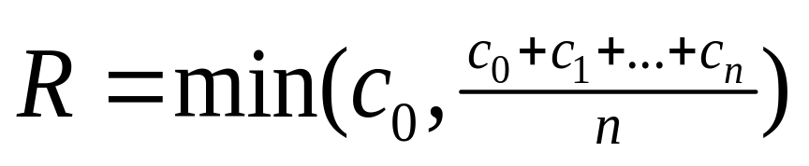
Scalable Content Distribution: P2P
Theoretical scalability
  assume upload is bottleneck
  then theoretical maximum streaming rate is:
server
C₀
C₁
client 1
C_{n}
C₂
C₃
client 2
client n
client 3

Slide 90
Theoretical Scalability:
c₀
Assume c₀ is relatively large
Tree i:
server → client i: c_{i} /(n-1)
client i → other n-1 clients
Tree 0:
server has remaining
c_{m} = c₀ – (c₁ + c₂ + … c_{n})/(n-1)
send to client i: c_{m}/n
c_{i} /(n-1)
c_{i}
c_{n}
c₁
c₂
C₀
c_{m} /n
C₁
C_{n}
C₂
C_{i}
*First derived in Mundinger’s thesis (2005).

Slide 91
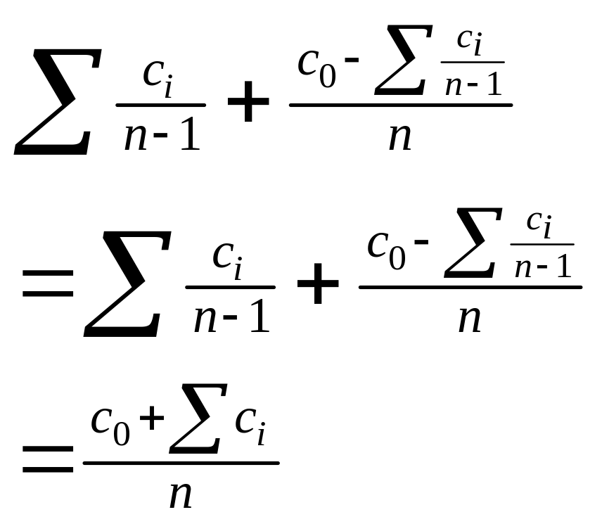
Theoretical Scalability
c₀
c_{i} /(n-1)
c_{n}
c_{i}
c₁
c₂
C₀
c_{m} /n
C_{n}
C₁
C₂
C_{i}
Notes:
Real scalability can be lower
But one P2P application reports supporting up to 2 Mbps streaming with only 4-5 Mbps server streaming

Slide 92
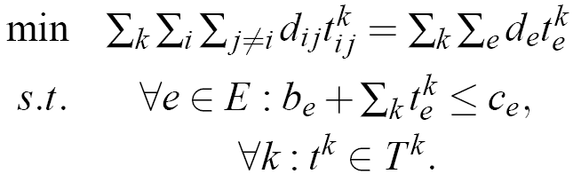
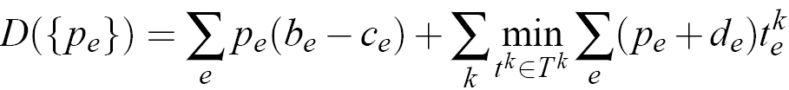
ISP Objective:
Bandwidth-Distance Product
Dual

Slide 93
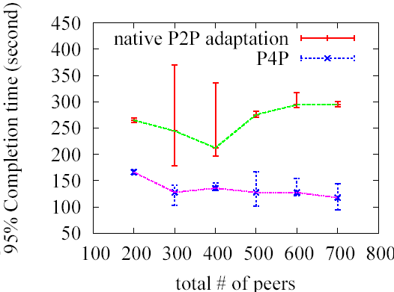
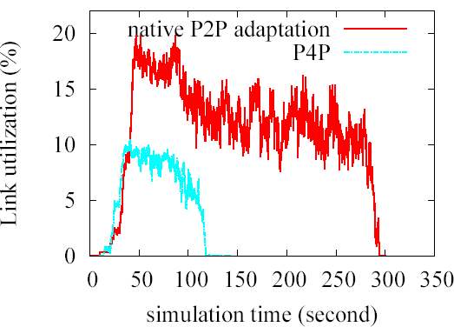
Evaluation – BitTorrent on Abilene
Compared to P4P, native P2P can result in
  2x download completion time
  2x higher link utilization
Native P2P can result in some peers experiencing very long download completion time
Native P2P can result in much larger variance in link utilization

Slide 94
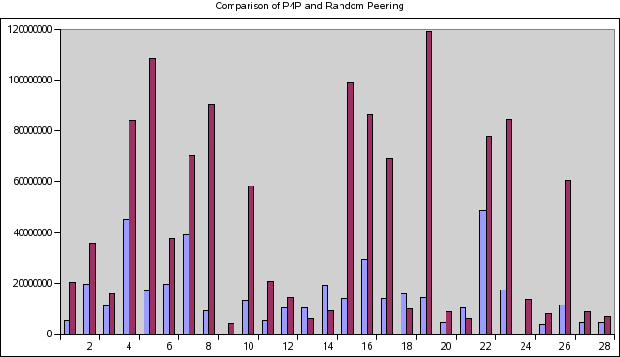
Evaluation – Liveswarms on PlanetLab
Liveswarms* is a P2P-based video streaming application, which adapts BitTorrent protocol to video streaming context
Run liveswarms on 53 PlanetLab nodes for 900 seconds
P4P and native liveswarms achieve roughly the same amount of throughput
P4P reduces link load
  Average link load saving is 34MB
  Maximum average link load saving is 60%
    Native liveswarms:1Mbps
    P4P liveswarms: 432Kbps
*Michael Piatek, Colin Dixon, Arvind Krishnamurthy, Tom Anderson. LiveSwarms: Adapting BitTorrent for end host multicast. Technical report: UW-CSE-06-11-01

Slide 95
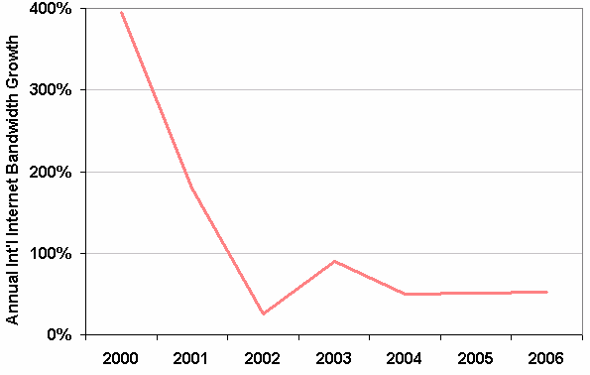
Internet Bandwidth Growth Stabilizing
Source: TeleGeograph Research
Notes:
AT&T predicts 50-fold increase in broadband to 2015 (75% per year)
Question: can we reduce BW usage of P2P?

Slide 96
P4P Framework: Data Path
ISP A
ISP B
b
a
Routers mark packets to provide faster, fine-grained feedbacks, e.g., virtual capacity to optimize multihoming cost and performance
- applications adjust traffic rates according to feedbacks
    Applications mark importance of traffic
Notes:
Advantages: faster response time and therefore better application performance and more efficient ISP resource usage
For example, use XCP style feedback to accelerate P2P
Applications mark importance of frames, e.g., video frames
Potential issues: why single out this class of applications.

Slide 97
P4P Control Path : Capabilities Interface
pTracker/content owner requests capabilities to accelerate content distribution.
pTracker
1
3
iTracker B
iTracker A
2
a
b
ISP A
ISP B
1: pTracker [content owner] queries ISP B’s iTracker
2: Provider B allocates servers to accelerate content distribution
3: pTracker includes ISP B’s servers in returned peering sets to peers
Notes:
We use ISP servers participation as an example. P4P allows other ISP capability requests, e.g., QoS, or Class of Service
The ISP can be a traditional ISP (AT&T, Verizon) or a virtual ISP (e.g., Akamai)
ISP selection of cache providers

Slide 98
Issue
How to optimize with percentiles?
Key issue: determine each ISP’s charging volume
Optimizing cost and performance for multihoming: SIGCOMM 2004

Slide 99
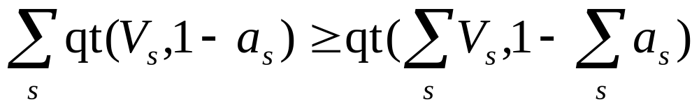
Quantile Inequality Lemma
Let qt(X, q): be the q * |X|-th value of X_{sorted} (or 0 if q <0), where X_{sorted} is X sorted in non-decreasing order
Then given S equal-length time series V_{s} and 0 < a_{s} < 1, for s = 1, …, S, we have

Slide 100

Optimal Sum of Charging Volumes

Slide 101
Cost Optimization: 2 ISPs Example
Sorted volume
Volume
v1
Sorted volume
Time
v1 + v2 is 90-th percentile of total traffic
v2

Slide 102

BitTorrent on Abilene: BDP

Slide 103

BitTorrent on ISP-A: BW-Delay Product

